Slide 1
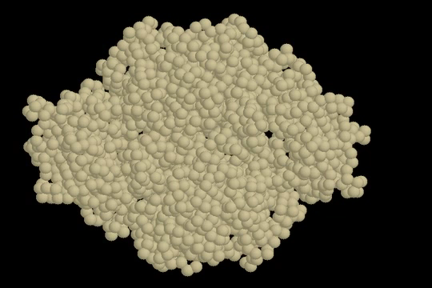
http://garlandscience.com/garlandscience_resources/resource_detail.jsf?landing=student&resource_id=9780815344469_CH03_QTM02
Enzyme Regulation
Control by Allostery:
Aspartate Transcarboxylase (ATCase)

